Slide 1




GRADE 4
TERM 3
TEST BUNDLE
PREVIEW
ATP Aligned

Slide 2

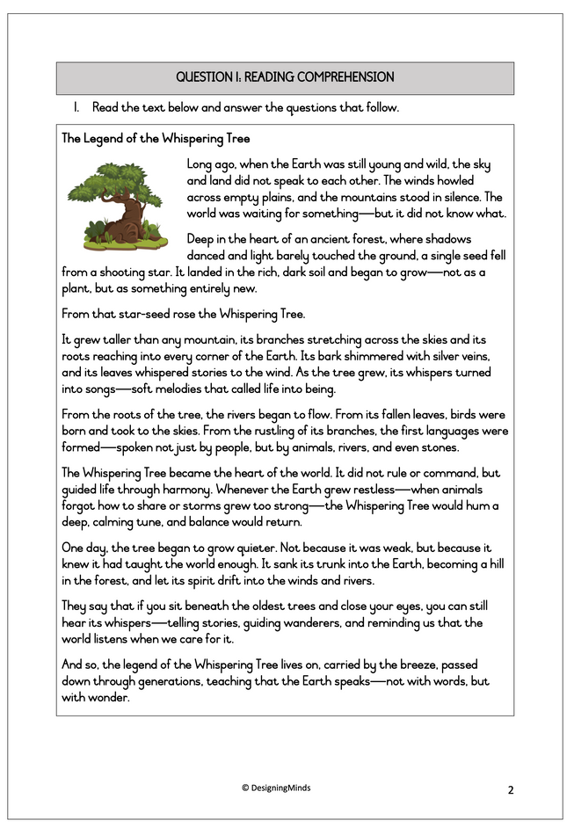
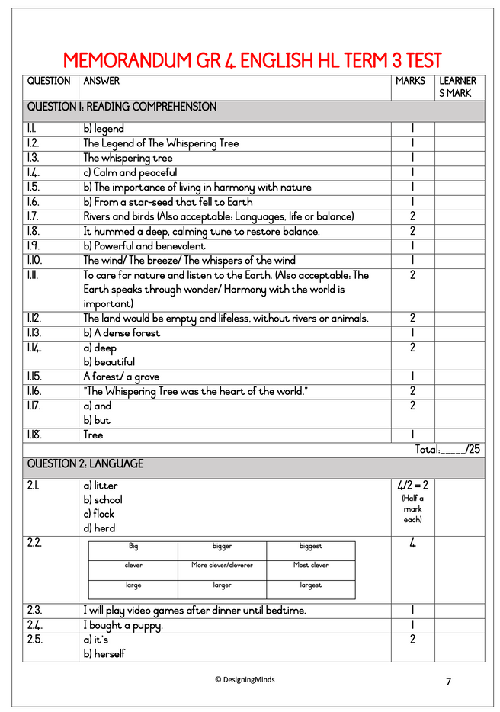
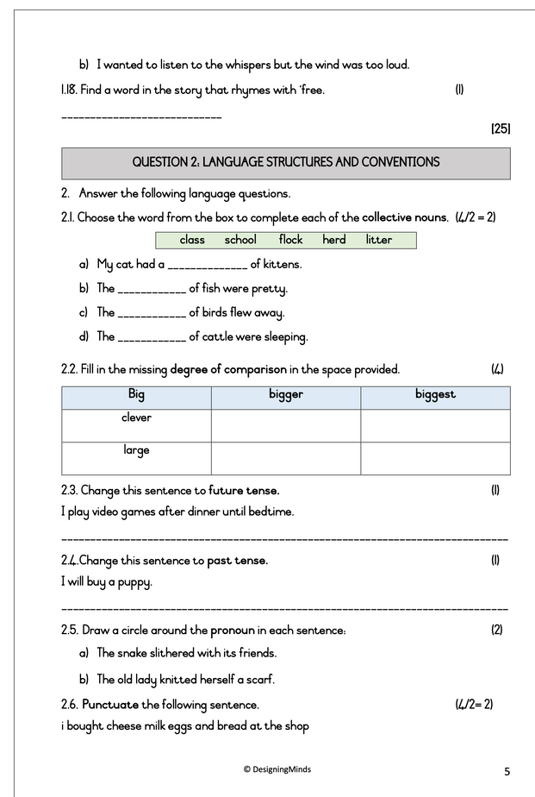

Grade 4 English HL Term 3 Test 1
Reading comprehension (25)
Language structures & conventions (15) (Opposites, collective nouns, metaphors, conjunctions, degrees of comparison, future tense, past tense, pronouns, prepositions, complex sentences, punctuation)
Test Total: 40
Number of pages: 8

Slide 3
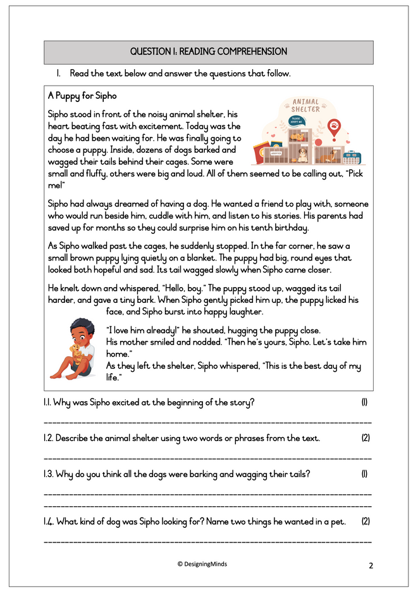
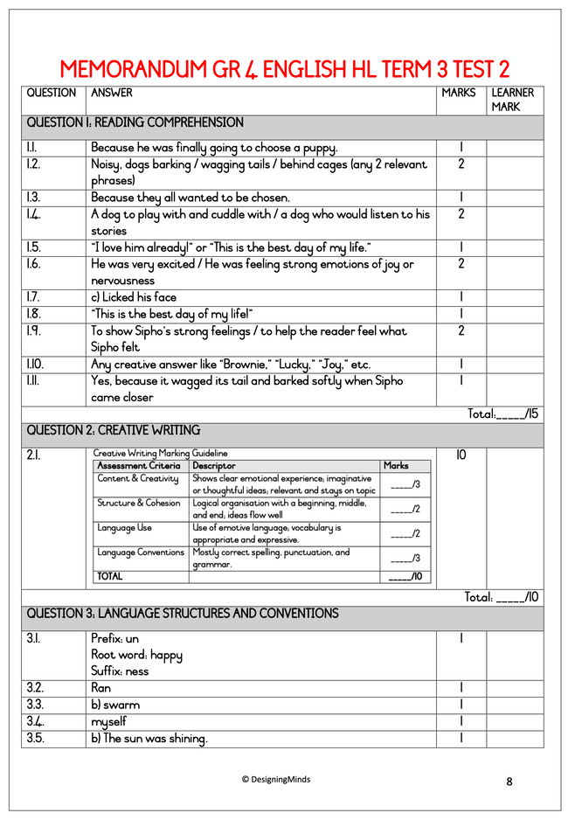
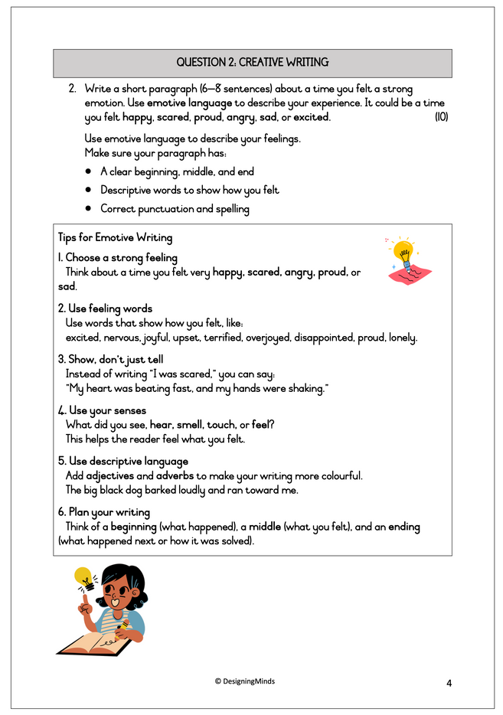
Grade 4 English HL Term 3 Test 2
Reading comprehension (15)
Creative Writing (10)
Language structures & conventions (15) (Root words, prefixes, past tense, collective nouns, reflex pronoun, simple sentences, conjunctions, verb, types of sentences, figures of speech, idioms, punctuation, abbreviations)
Test Total: 40
Number of pages: 9

Slide 4
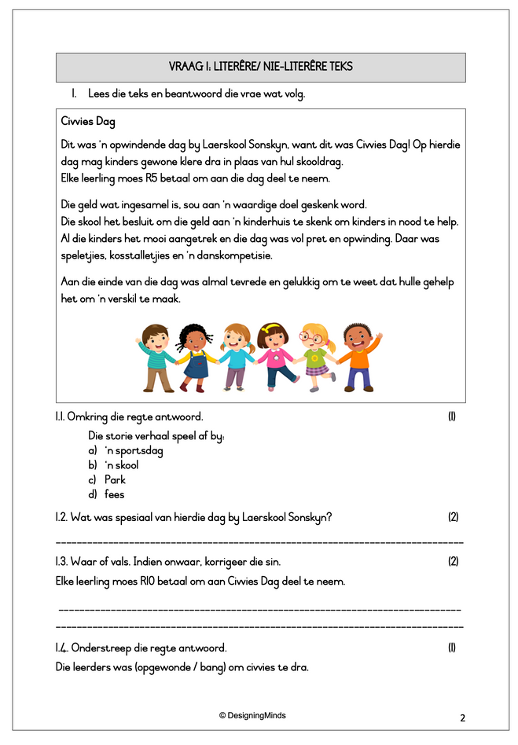
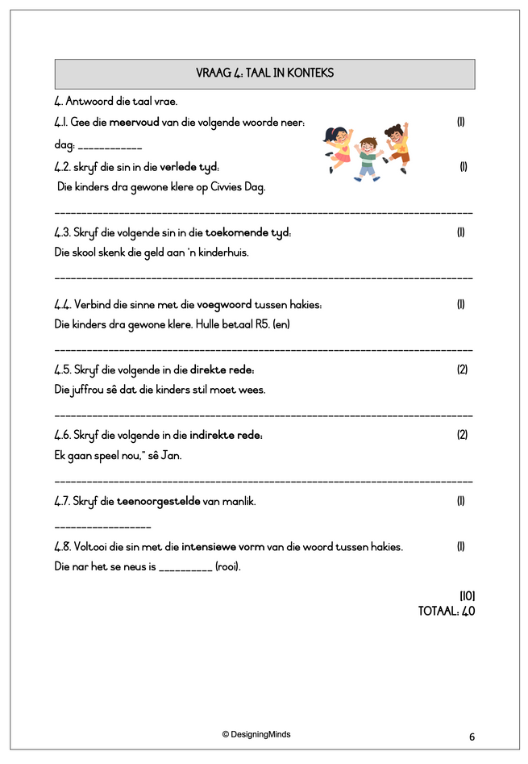
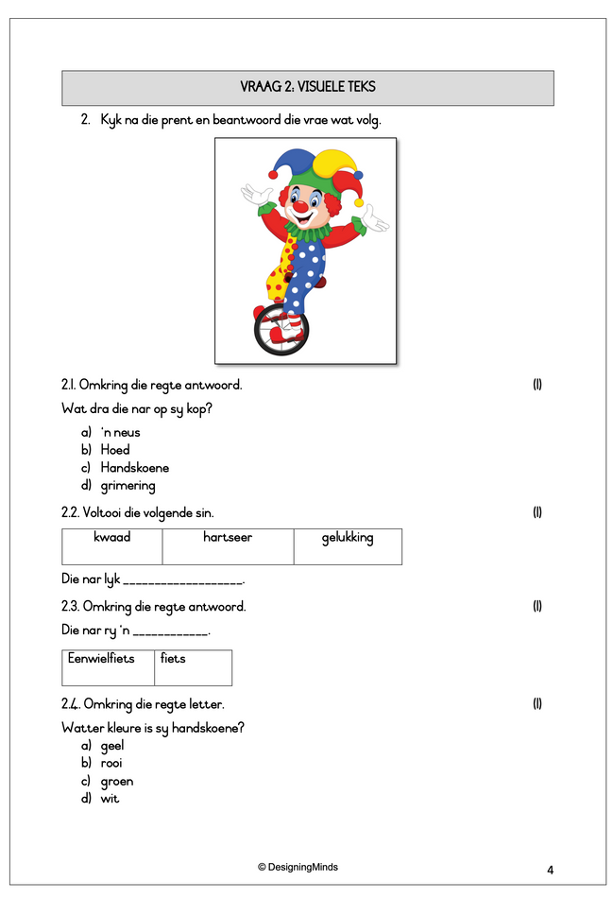
Grade 4 Afrikaans FAL Term 3 Toets 1
Begripstoets (15)
Visuele teks (10)
Opsomming (5)
Taalwerk (10)
Test Total: 40
Number of pages: 8

Slide 5
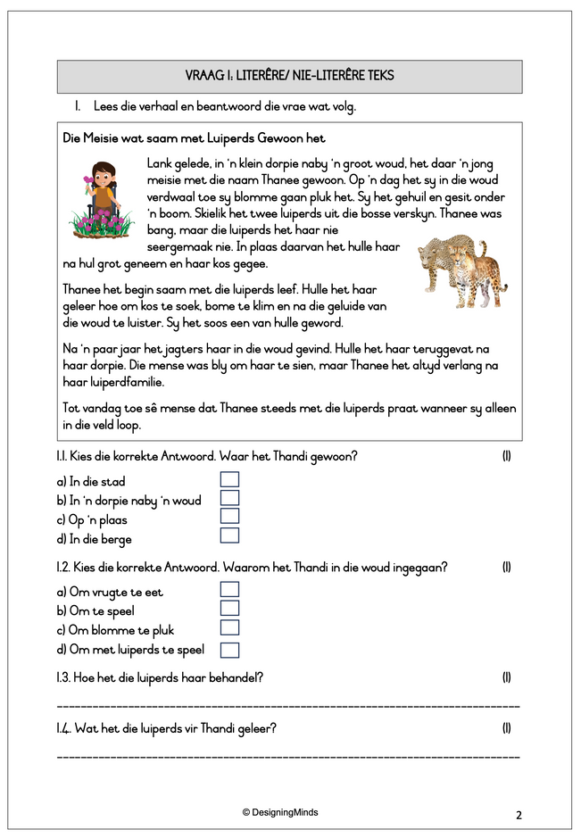
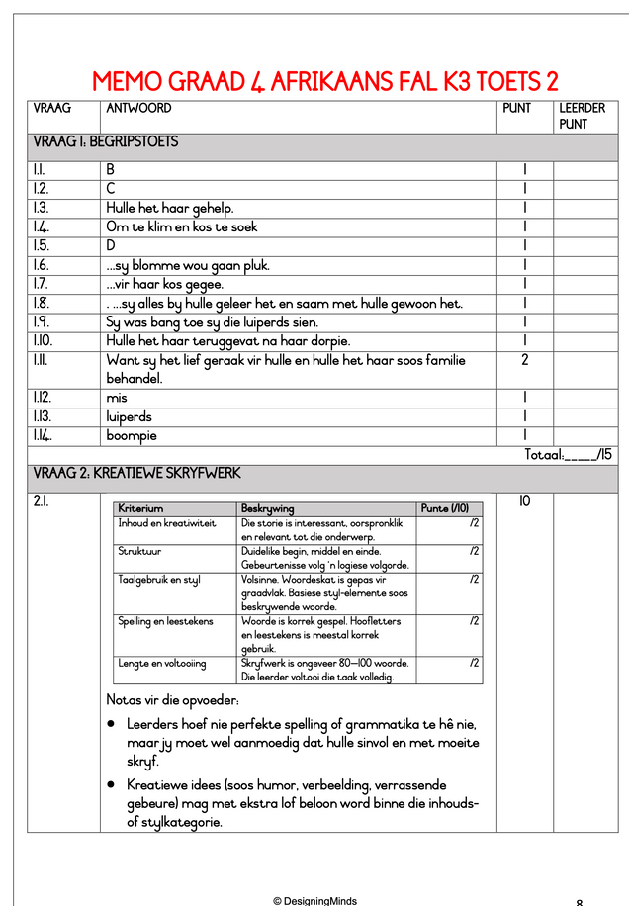
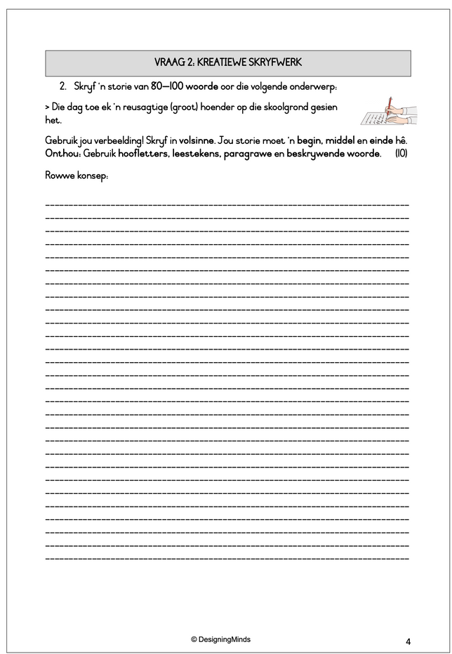
Grade 4 Afrikaans FAL Term 3 Toets 2
Begripstoets (15)
Kreatiewe Skryfwerk 10)
Taalwerk (15)
Test Total: 40
Number of pages: 9

Slide 6
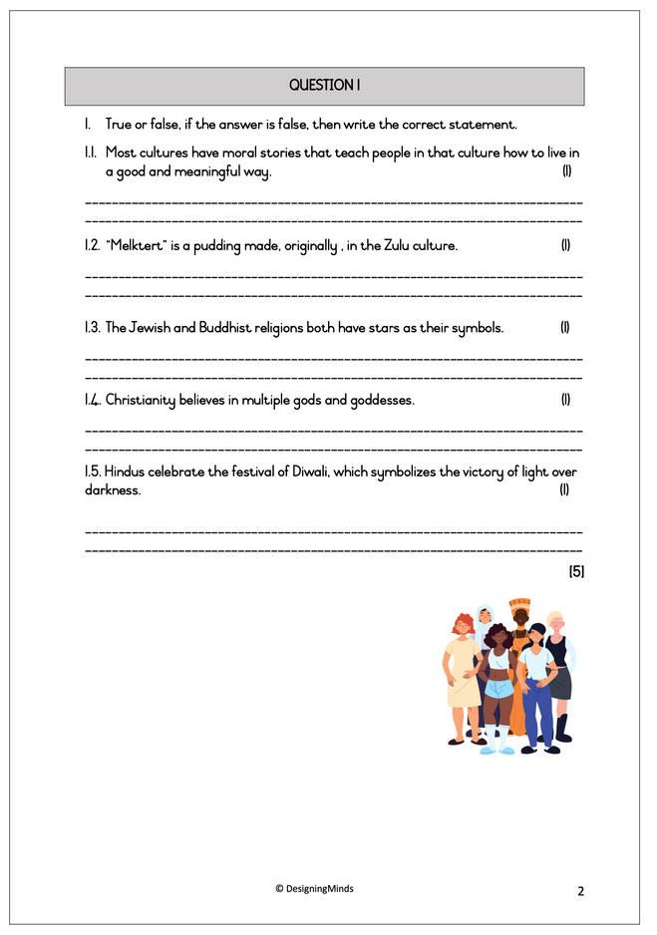
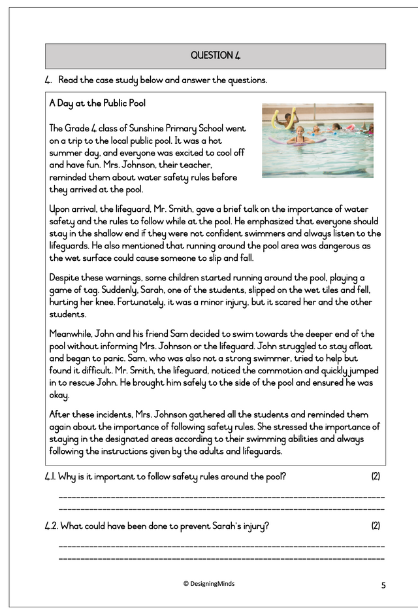
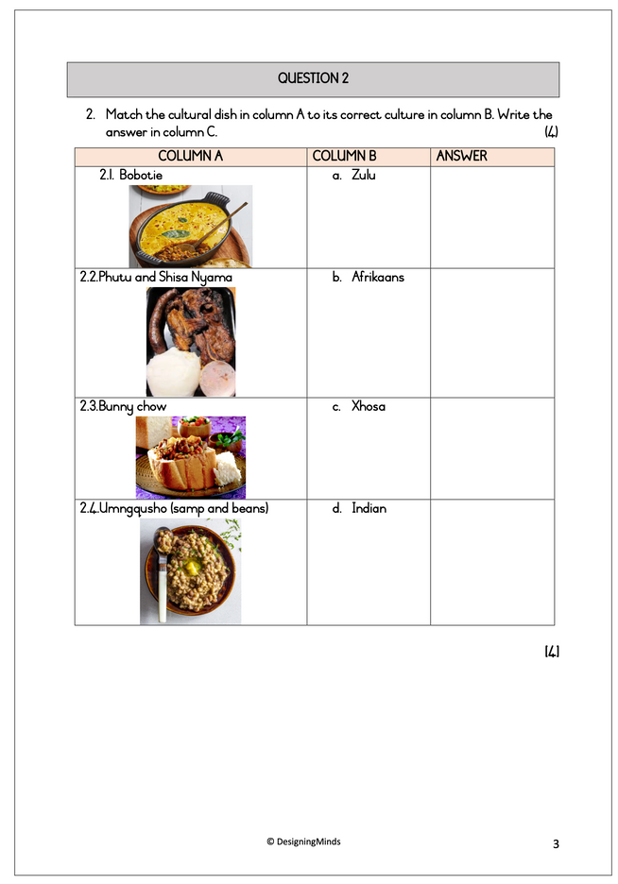
Grade 4 Life Skills PSW Term 3 Test 1
Cultures & moral lessons
Menus in South Africa cultures
Learning from leaders
Different religions
Test Total: 30
Number of pages: 8

Slide 7
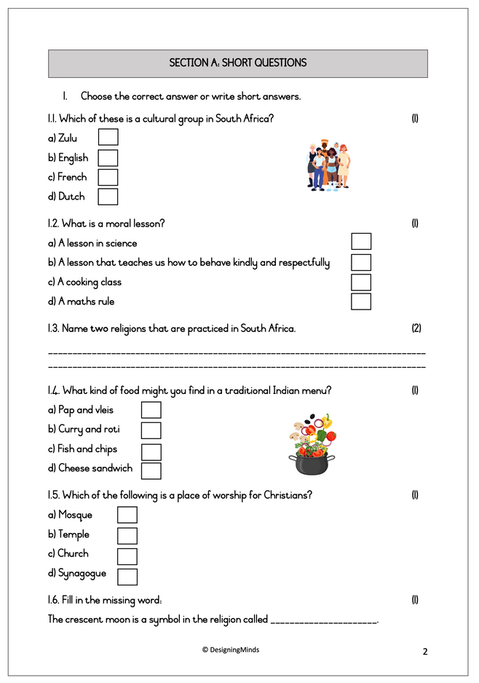
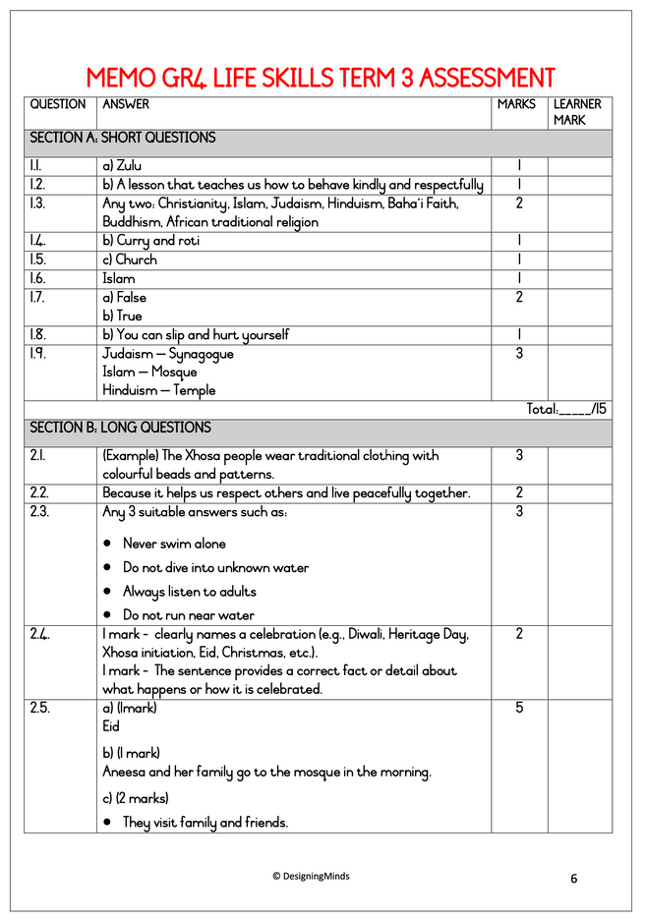
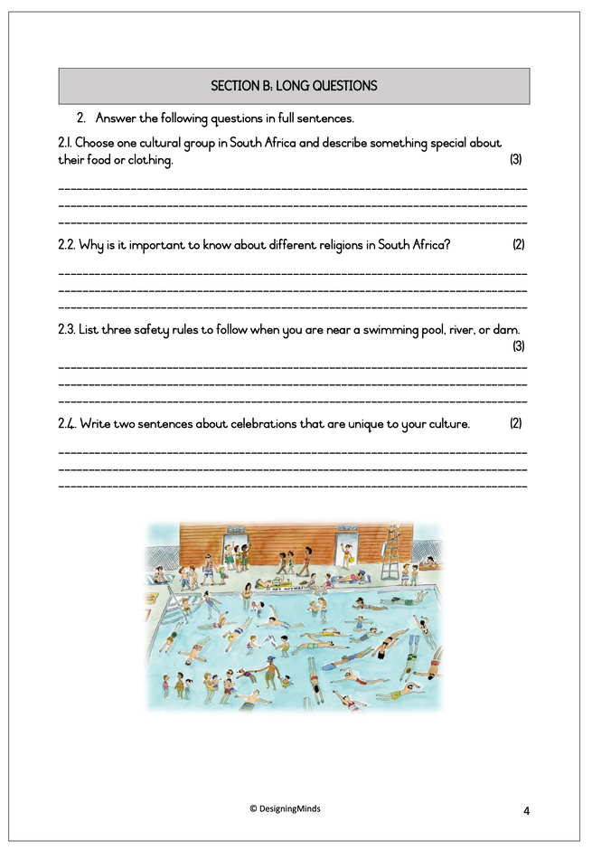
Grade 4 Life Skills PSW Term 3 Assessment
Cultures & moral lessons
Menus in South Africa cultures
Different religions in SA
Dangers around water
Test Total: 30
Number of pages: 7

Slide 8
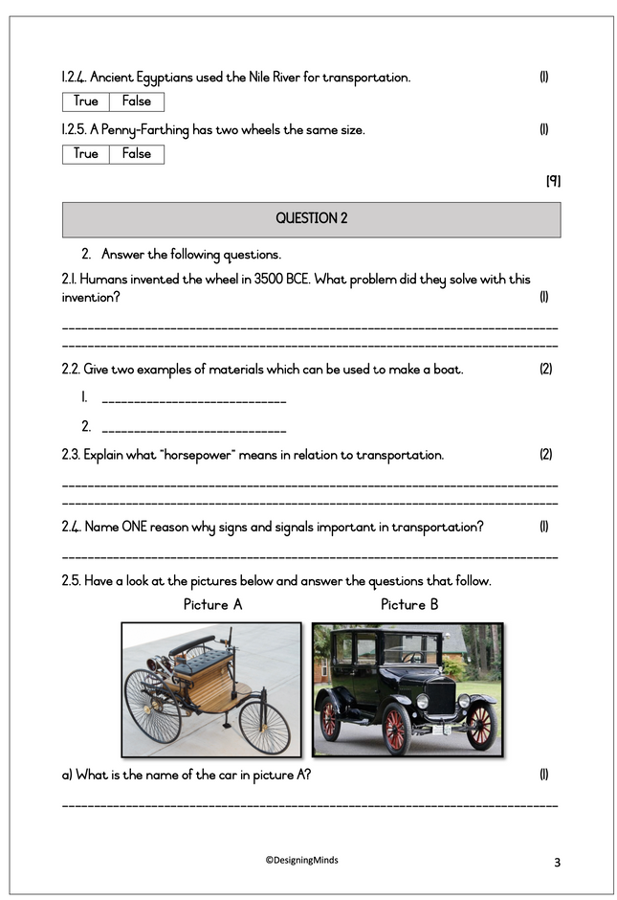
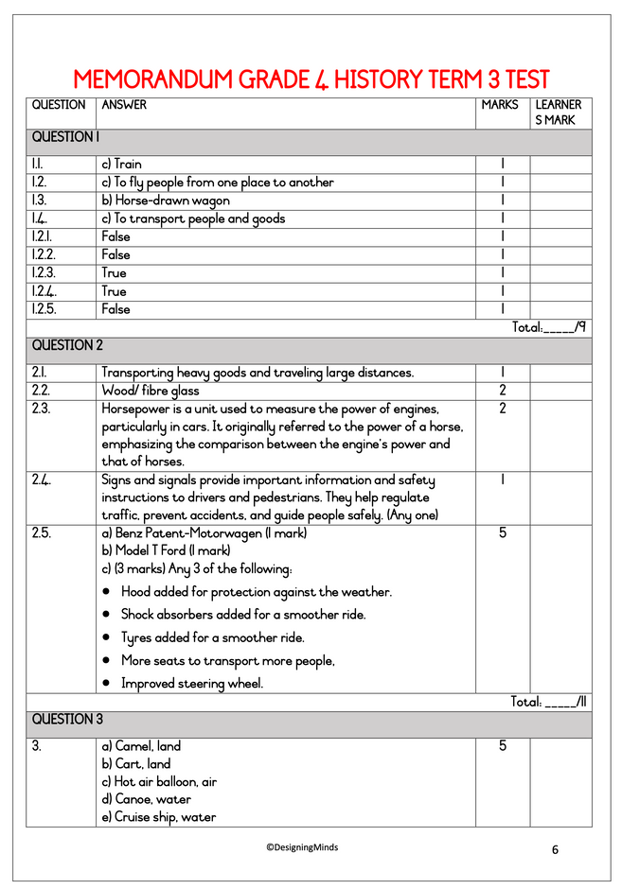
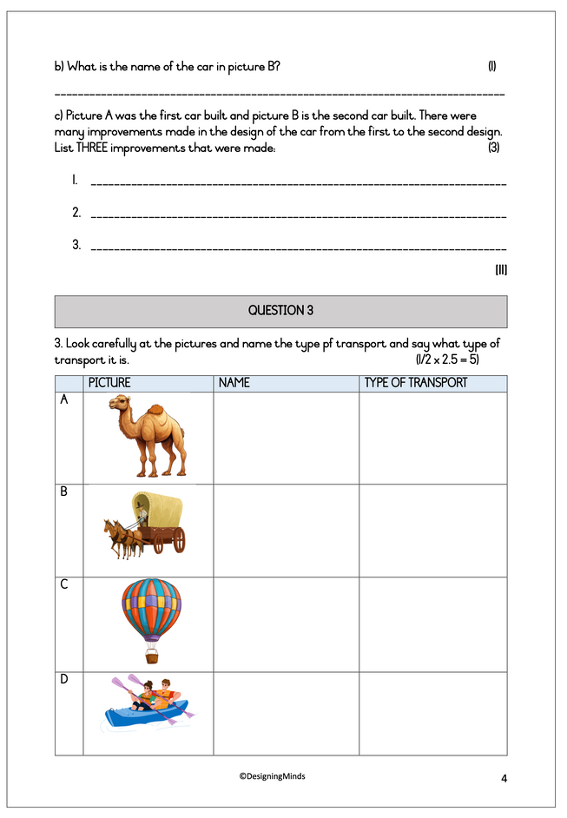
Grade 4 HistoryTerm 3 Test 1
Transport on land, water & air
Transport through time
Test Total: 25
Number of pages: 7

Slide 9
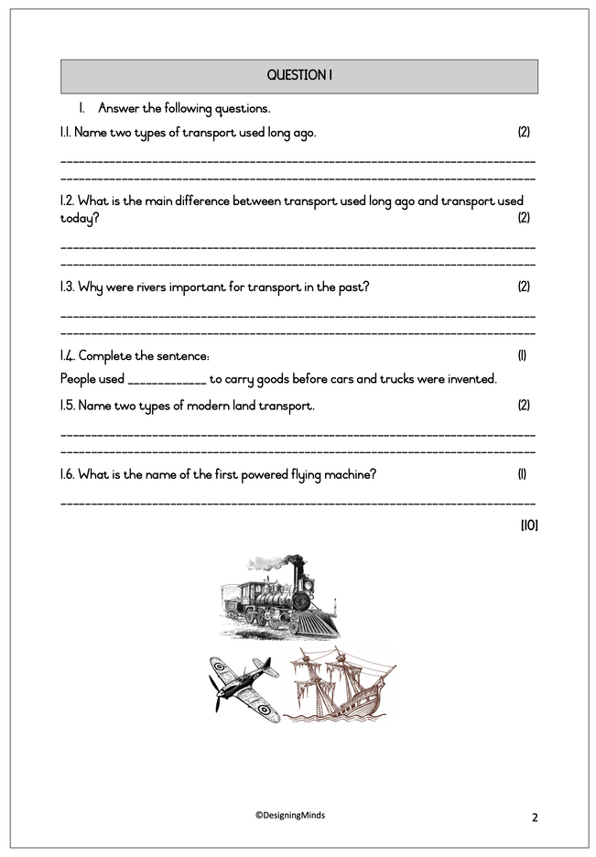
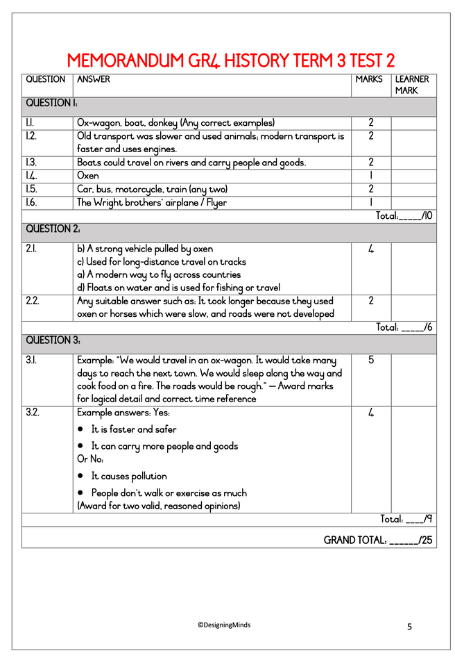
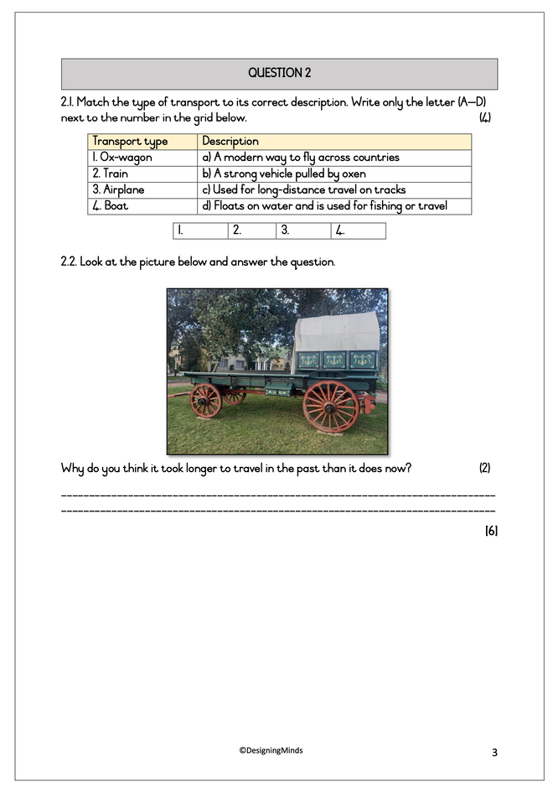
Grade 4 History Term 3 Test 2
Transport on land, water & air
Transport through time
Test Total: 25
Number of pages: 5

Slide 10
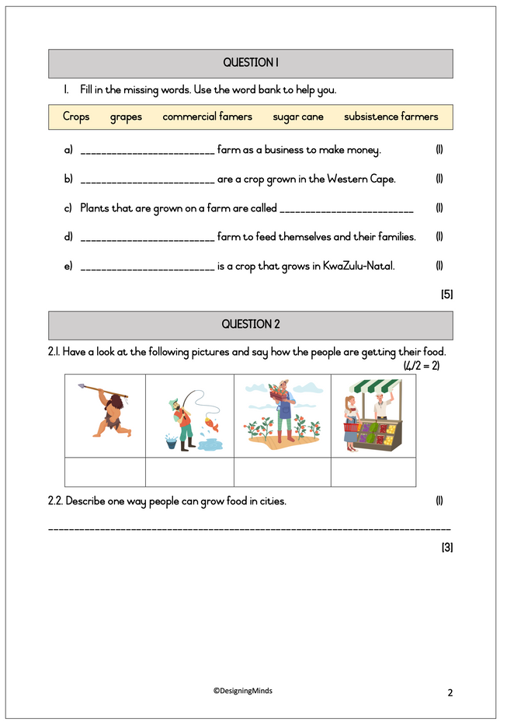
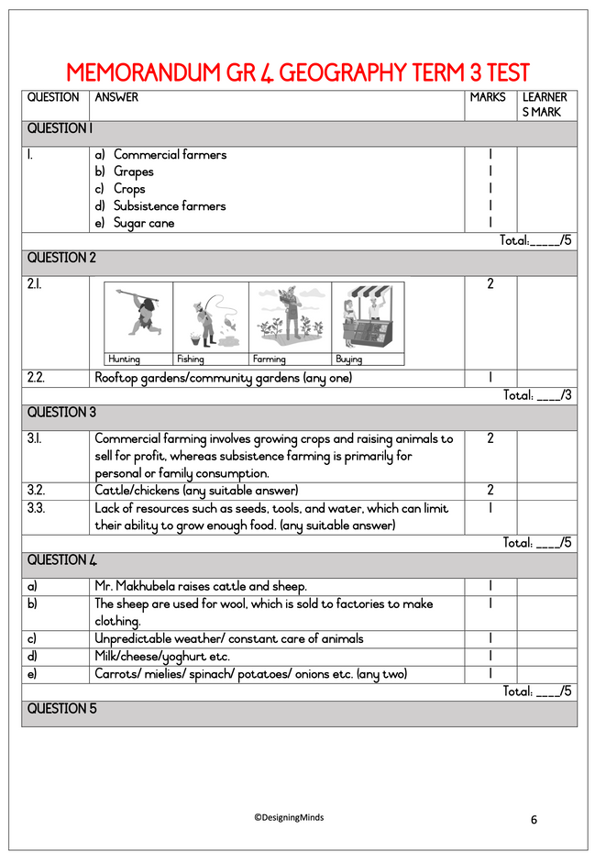
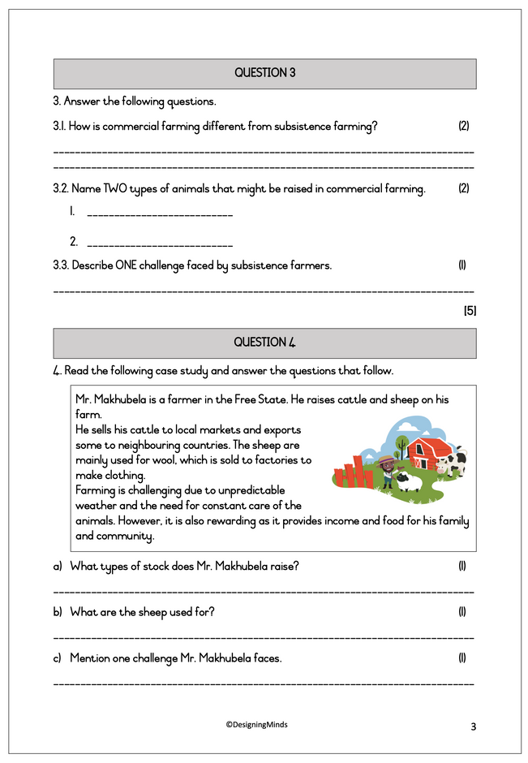
Grade 4 Geography Term 3 Test 1
People & food
Ways of farming
Crop & stock farming
Test Total: 25
Number of pages: 7

Slide 11
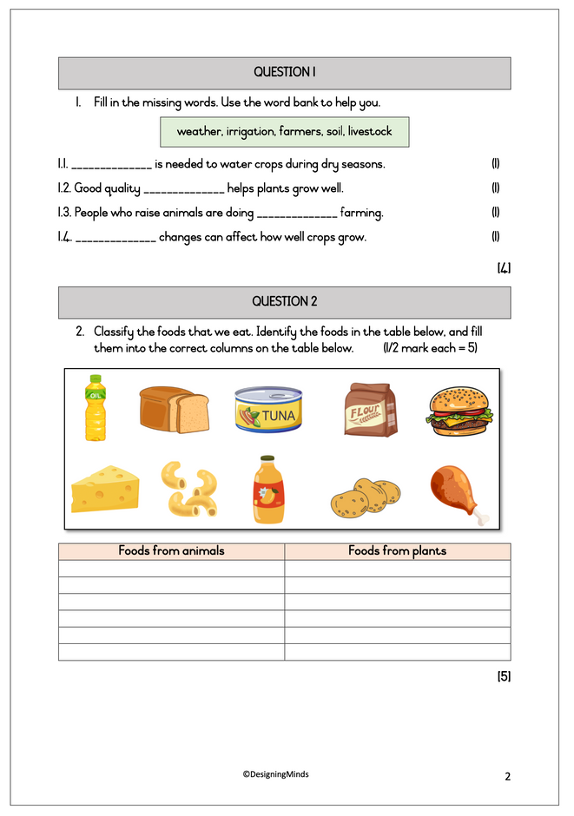
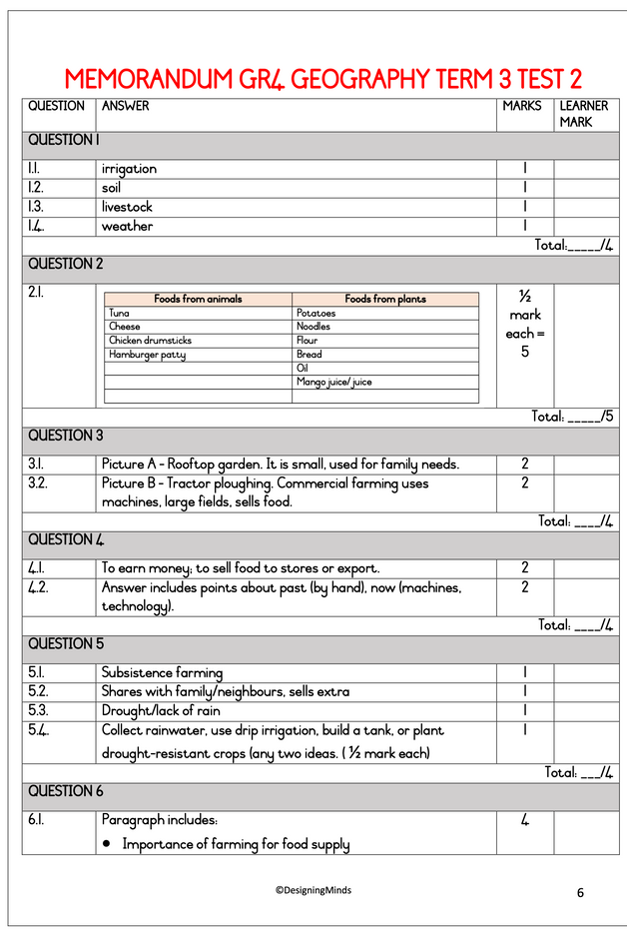
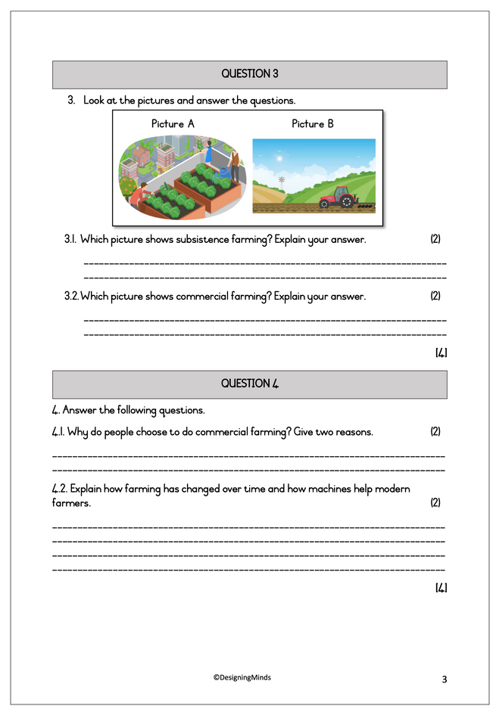
Grade 4 Geography Term 3 Test 2
People & food
Ways of farming
Crop & stock farming
Test Total: 25
Number of pages: 7

Slide 12
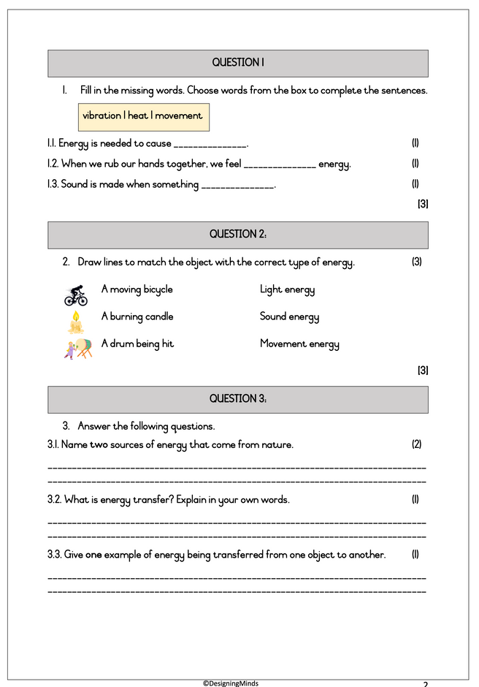
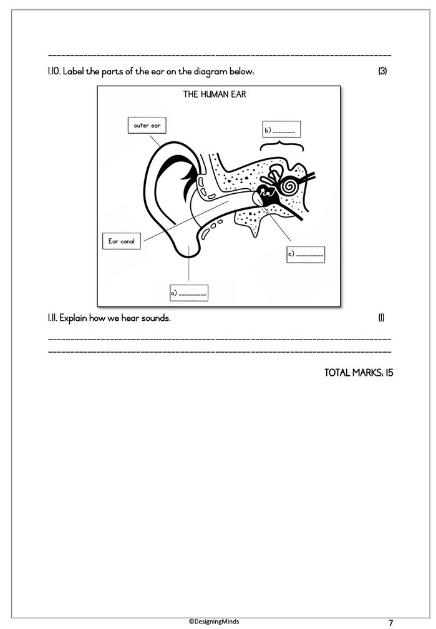
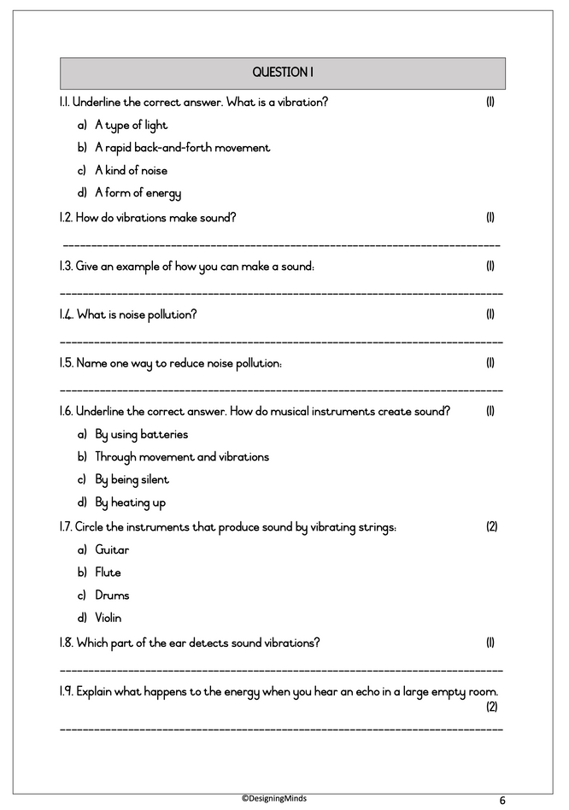
Grade 4 NST Term 3 Test 1,2 & 3
There are 3 x 15 mark tests
Tests cover the following topics:
Energy & energy transfer
Energy around us
Movement & energy in a system
Energy & sound
Number of pages: 12

Slide 13
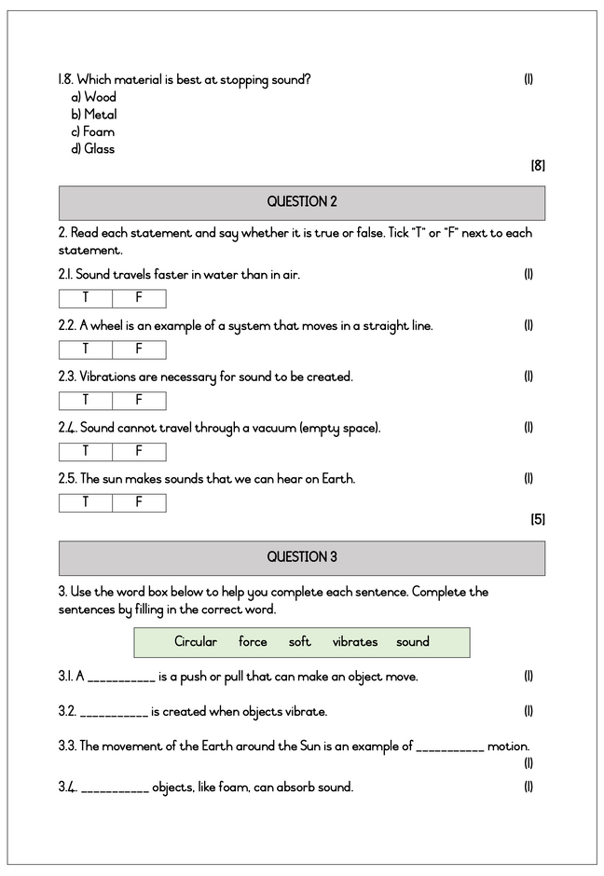
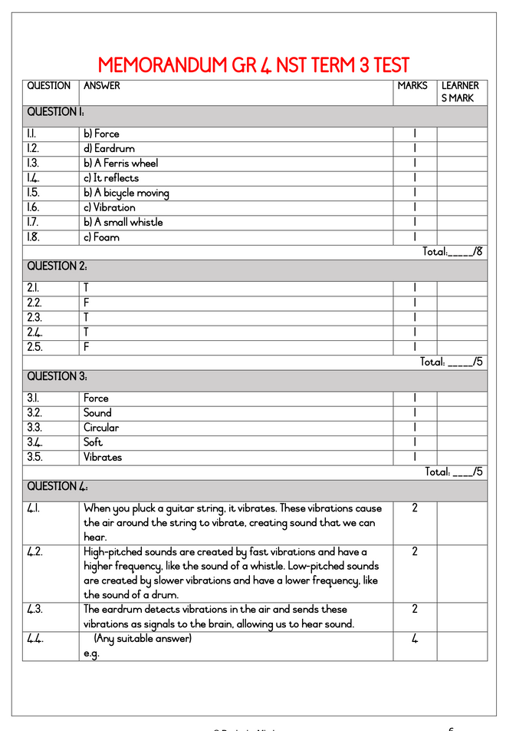
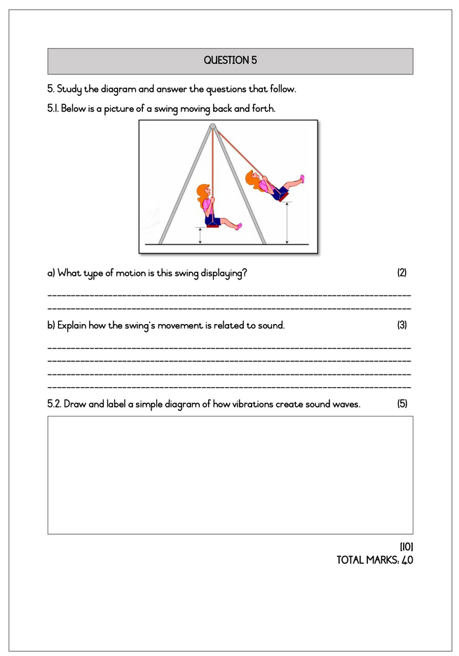
Grade 4 NST Term 3 Test
Energy & energy transfer
Energy around us
Movement & energy in a system
Energy & sound
Test Total: 40
Number of pages: 7

Slide 14
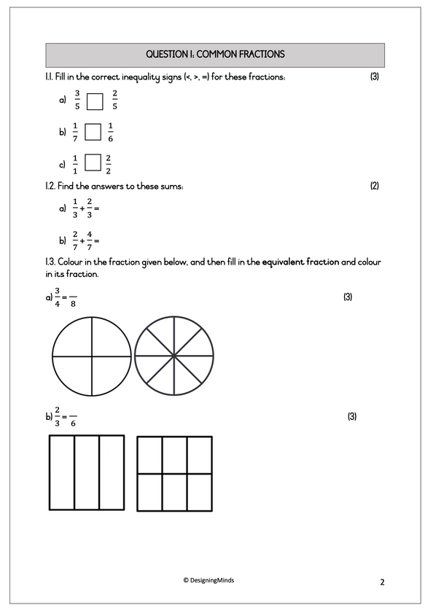
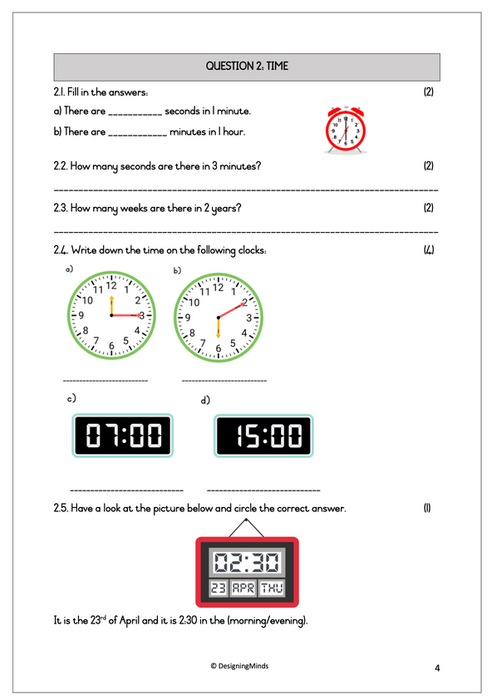
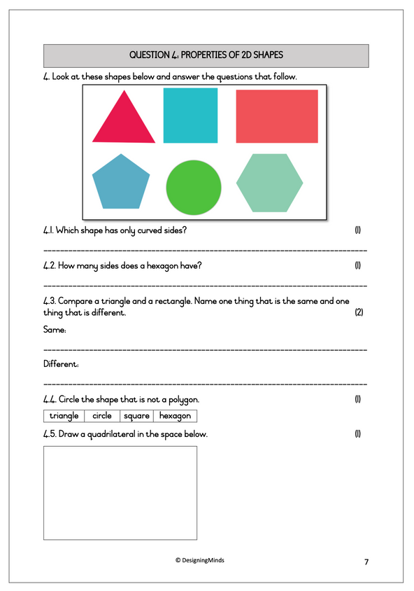
Grade 4 Mathematics Term 3 Test 1
Fractions
Time
Length
Properties of 2D shapes
Test Total: 50
Number of pages: 10

Slide 15
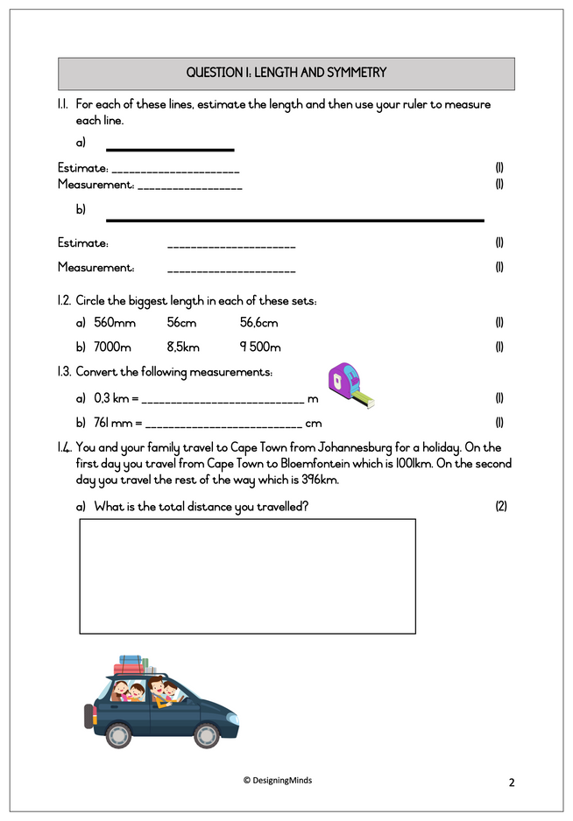
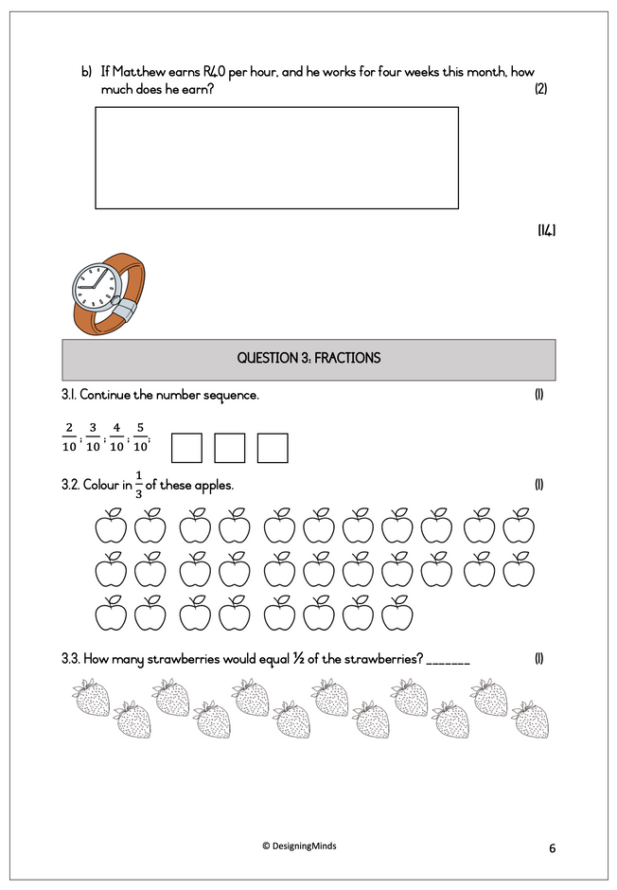
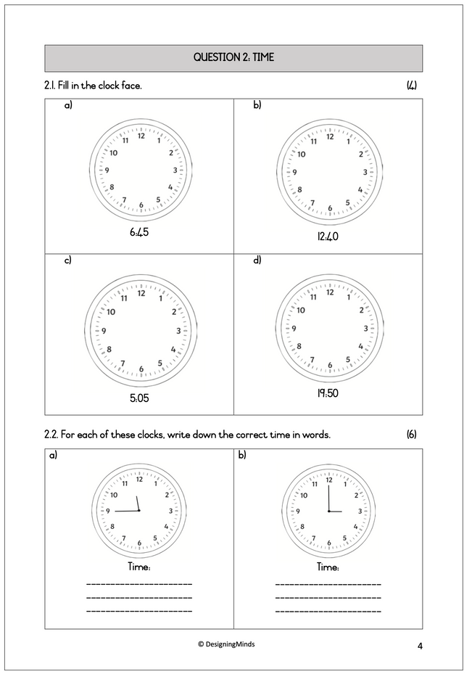
Grade 4 Mathematics Term 3 Test 2
Fractions
Time
Length & symmetry
Properties of 2D shapes
Test Total: 50
Number of pages: 12

